Slide 1
Cross-Channel Fundraising Strategies
Tanya Zumach, Metropolitan Group
Betsy Harman, Harman Interactive
Jeff Regen, Defenders of Wildlife
Notes:
Tanya: Introduce panel

Slide 2
What is it?
Level 1 - getting donors and activists into different streams - online, direct mail, and/or telemarketing
Level 2 - Strategic, planned coordination
Notes:
Tanya: There are lots of good practices to coordinating your communications and fundraising activities, but for our purposes today this is how we’re defining cross-channel. This is new, and we don’t have all the answers. Data is random, mostly anectodal.

Slide 3
Agenda
Introductions
Why & Stats
Samples & Case Studies
Obstacles & Challenges
Q/A & Audience Sharing
Notes:
Tanya: Don’t leave Q& A to end, please participate throughout. Any burning questions you really want to be sure that we cover today?

Slide 4
Multi-channel most valuable
Value from least to most:
  Offline donors w/o email
  Offline donors w/ email
  Online donors
  Online/offline donors
Notes:
Jeff

Slide 5
Multi-channel most valuable
(possibly offline, too)
Source: Defenders of Wildlife
Notes:
Jeff

Slide 6
Channel Migration
Non-online donors in 2005 (who gave in 2006):
  97.5% gave offline only
  2.5% gave online (and in some cases offline)
Online donors in 2005 (who gave in 2006):
  41% gave offline only
  59% gave online (and in some cases offline)
Source: Defenders of Wildlife
Notes:
Jeff: Rarely have email addresses for offline only donors, online covert to offline perhaps because of renewal practices.

Slide 7
The Donor Viewpoint
Phone says “emergency” but Web does not
Activist appeal says “we won” but mail says “we need your help”
“I just gave last week!”
“Hmmm, this piece says I can donate to kittens, but the Web site doesn’t”

Slide 8
Donor Mashup
Gather Offline emails
Offline donors/prospects to Website
Online donors/activists to Mail and/or phone streams
Others?
Notes:
Tanya: If you’re just getting started with cross-channel, here are some ways to take the first steps. Now, wer’re going to show some examples of coordinated campaigns.

Slide 9
Example Plan
 | Sept | Oct | Nov. | Dec
E-Newsletter | 9/15 | 10/15 | 11/15 | 12/15
Pre Telemarketing e-mail | 9/20
TM campaign starts |  | 10/1
Year end direct mail |  |  | 11/20
Year End E-Mail hits 1 and 2 |  |  |  | 12/20 / 12/28
Notes:
Betsy

Slide 10
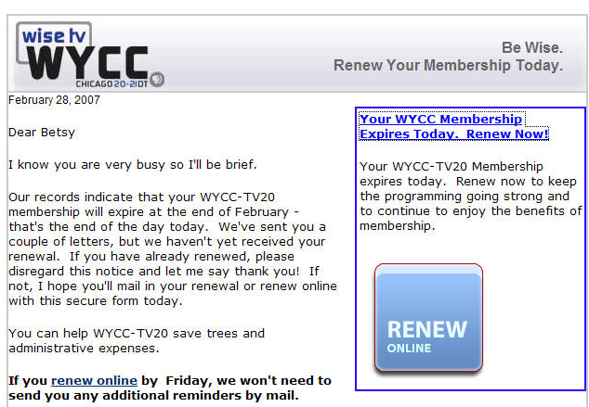
Email direct mail email
Notes:
Betsy: renewal series pbs stations are using that is a series of email and direct mail together and encourages people to respond online ASAP to
avoid the need to send further messages by mail. [Stress message of this]

Slide 11
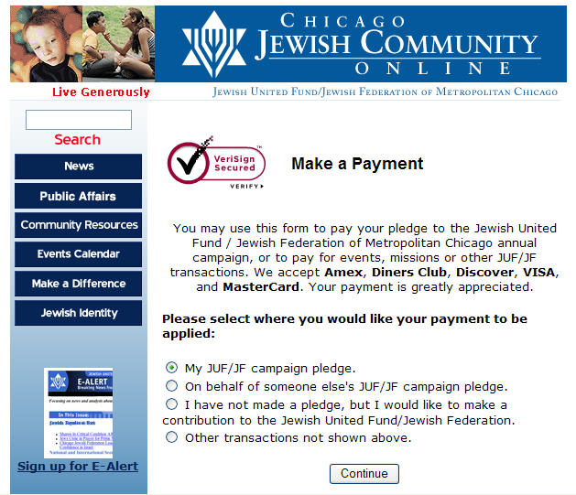
Major donor pledge online
Notes:
Betsy

Slide 12
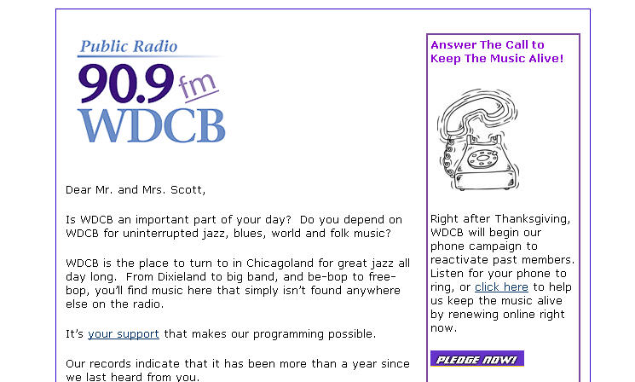
Email telemarketing
Notes:
Betsy: the advance email can assure people that the calls are legit

Slide 13
Activists telemarketing
Segments of activists profitable
Sustainer ask appears to be best
15% lower fulfillment rate
Source: Defenders of Wildlife

Slide 14
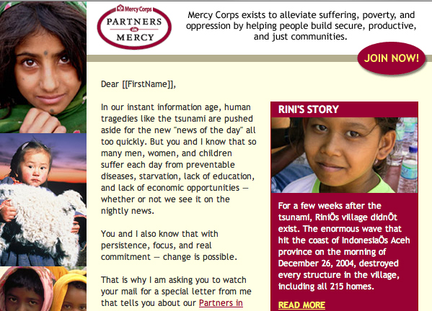
Email direct mail
Email segment 150% greater response
Notes:
Tanya: Direct mail monthly giving ask had four segments. The one with the pre-email raised response 150% overall - not to mail piece, but online, but not in direct response to email

Slide 15
Breaking Down Silos
Communications vs. Government Relations vs. Fundraisers - who “owns” the name?
Mail, phone, Internet fundraisers have goals, lists, different expertise
Data usually not in shared location
Internal politics, personalities, structure
Vendors & consultants (mail, Internet, phone)
Notes:
Jeff

Slide 16
Breaking Down Silos
Share calendars, plans
Cross-online team
Cross-channel team
Share goals, credit
Plan ahead to meet deadlines
Notes:
Jeff

Slide 17
Data, Data, Data
Sync between eCRM and database painful
Time consuming, complex, expensive
Vendors often “learning, too” at best;
hostile at worst
Metrics, evaluation data different
Notes:
Jeff

Slide 18
Data, Data, Data
Prepare management, define expectations
Line up internal resources
Create budget cushion
Define what’s “critical” vs. “nice-to-have”
Common ROI - $ return for $ invested
Notes:
Jeff

Slide 19
Message & Brand
Each channel has style that works best
Audiences are different
Messages don’t need to be identical
Develop campaigns or themes
Test!
Notes:
Tanya: Common wisdom is that a 4-page direct mail letter usually works best, but online - yeah, right! Media differ in tone, space, graphics,
response device

Slide 20
Maybe not…
Data challenges too severe, complex, costly
List protection/silos too much to overcome
Audiences are so different
No management support
Not worth the investment
Notes:
Tanya

Slide 21
Contacts
Tanya Zumach, ePMT
  Senior Director of Online Strategy
  Metropolitan Group, Portland, OR
  tzumach@metgroup.com, 503-233-3299
Betsy Harman, ePMT
  Principal, Harman Interactive, Chicago, IL
  betsyharman@earthlink.net, 773-728-4194
Jeff Regen
  VP, Online Marketing & Communications
  Defenders of Wildlife, Washington DC
  jregen@defenders.org, 202-772-3216

